Slide 1
Results of the 2011 Global IPv6 Deployment Monitoring Survey
Based on responses to the 2011 Global IPv6 Deployment Monitoring Survey from the global RIR community during July 2011
-
Maarten Botterman – maarten@gnksconsult.com
Delivered by Chris Buckridge, RIPE NCC

Slide 2
Based on 1656 respondents from 135 countries
46% of originating from the RIPE NCC service region
Very similar “profile” as in 2010 and 2009

Slide 3
Does your organization have, or consider having an IPv6 allocation and/or assignment?
* Q10 responses. “consider” was not a seperate option in survey 2010 but combined in “Yes”
source: GNKS 2011

Slide 4
ISP: What percentage of your customer base uses IPv6 connectivity?
* Q17 responses, question asked to ISPs only
source: GNKS 2011

Slide 5
IPv6 implementation
implemented
plans
No plans
Notes:
If we look to the IPv6 implementation and implementation planning since 2009, we see that the community participating to the survey is clearly totally convinced and moving towards implementation, across the board.

Slide 6
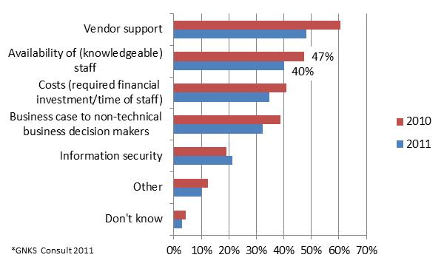
Biggest hurdles when deploying IPv6...
* Responses to survey Q16 - What are likely to be the biggest hurdle(s) when deploying IPv6? Based on experience with organisations who implemented IPv6 (71% in 2011) or have started planning for its implementation (22% in 2011).
Notes:
We see that on all front the experience of hurdles has become less over the last year – with the exception of information security.

Slide 7
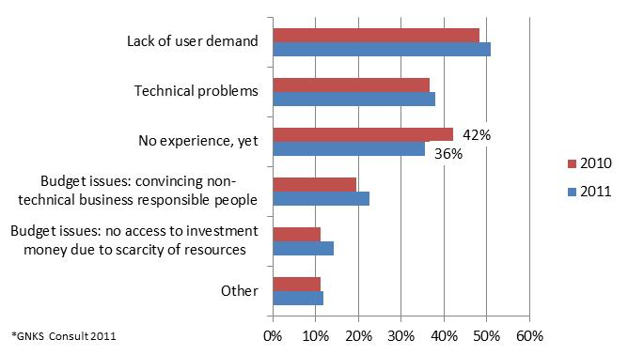
Biggest problems with IPv6 in practice
* Responses to survey Q17 - What are the biggest problems with IPv6 in production? Based on experience with organisations who have IPv6 in production.
Notes:
Remaining a clear conclusion: user demand is still hardly there. And experience is just picking up...

Slide 8
Questions?
Read the full survey results at: http://www.nro.net/wp-content/uploads/ipv6_deployment_survey.pdf
Or email Maarten Botterman: maarten@gnksconsult.com

