Slide 1
Stateless IPv4 over
IPv6 in 5 minutes
DS-lite
6rd
A+P
Ole Trøan, ot@cisco.com
IPv6 mercenary
2011-11-01

Slide 3









Dual Stack Lite (DS-Lite)
Private IPv4
IPv6
IPv4 in IPv6 Tunnel
Private IPv4
IPv6
IPv6
IPv6
IPv4
IPv4
IPv4 in IPv6 Tunnel
Private IPv4
IPv6
Subscribers
Providers
Internet

Slide 4


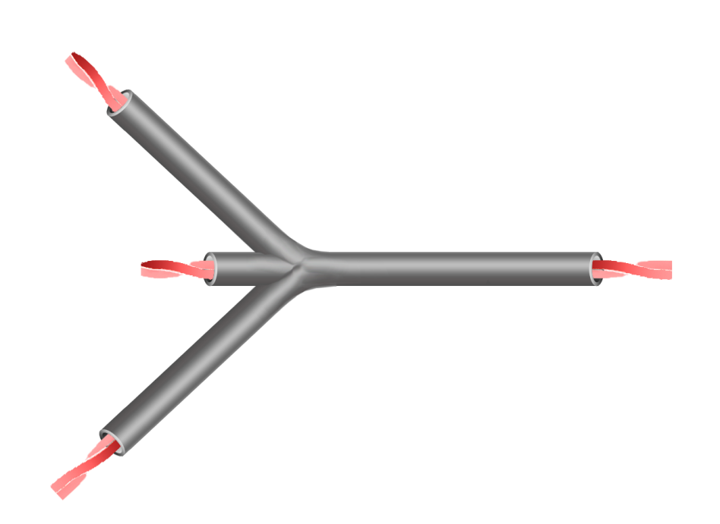


IPv6 Dual IVI (dIVI)
IPv6 Residual Deployment (4rd)
Private IPv4
IPv6
Private IPv4
IPv6
IPv6
IPv6
IPv4
IPv4
Private IPv4
IPv6
Subscribers
Providers
Internet

Slide 5
IPv6 → IPv4 + Port Mapping
IPv6 Delegated Prefix (e.g., /X)
Size = X bits (provisioned)
Y - Z = a
2001:0DB8:00 /X
01010101 111000
Subnet-ID
Interface ID
0
Mapping Domain Prefix
/X
“EA Bits”
/Y
64 (fixed)
Z bits (provisioned)
32 – Z = b
6 (fixed)
a - b = c
10-c
130.67.1 /Z
01010101
+
> 0
111000
XXXX
0
IPv4 Prefix
/Z
IPv4 Suffix
32
0
6
6+c
16
Port Set ID
+
IPv4 Address
Port

Slide 6
IPv6 → IPv4 + Port Mapping
IPv6 Delegated Prefix (e.g., /56)
Size = 42 bits (provisioned)
56-42 = 14
2001:0DB8:00 /42
01010101 111000
Subnet-ID
Interface ID
0
Mapping Domain Prefix
42
“EA Bits”
/56
64 (fixed)
For this Example…
24 bits (provisioned)
32-24 = 8
6 (fixed)
14-8 = 6
10-6 = 4
130.67.1 /24
01010101
+
> 0
111000
XXXX
2⁶=64 port sets
per IPv4 Address
0
IPv4 Prefix
24
IPv4 Suffix
32
0
6
12
16
Port Set ID
Ports 0-1023 skipped,
each CPE gets
2¹⁶/2⁶ - 2⁴ = 1008 ports
+
IPv4 Address
Port
One IPv4 /24 serves
2⁽⁶⁺⁸⁾ ≈ 16,384 (vs.≈256)
subscribers
130.67.1.85/38

Slide 7

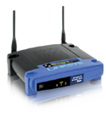
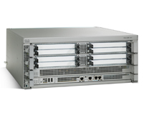
Encapsulation Forwarding Architecture
Private IPv4
NAPT 44
(w/ALGs)
MAP IPv4 Address and Port to IPv6
Encap in IPv6
Forward IPv4
Check IPv4 to IPv6 Mapping
Decap IPv6
IPv4 Internet

Slide 8
Translation Forwarding Architecture
Private IPv4
NAPT 44
(w/ALGs)
MAP IPv4 Address and Port to IPv6
Replace IPv4 Header with IPv6 Header
Forward IPv4
MAP and recreate IPv4 Header
Decap IPv6
IPv4 Internet

Slide 9
Encapsulation or Translation – Boils down to 20 bytes
4rd
4rd
IPv4 + IPv6
Ingress IPv4 Traffic
IPv4 + IPv6
Egress IPv4 Traffic
IPv4 + IPv6
CE
Native IPv6 Infrastructure
BR
Transport
Transport
IPv4
Transport
Transport
IPv6
OR
IPv6
IPv4
IPv4
IPv4
Link
Link
Link
Link

Slide 10
Please
Readhttp://tools.ietf.org/html/draft-mdt-softwire-mapping-address-and-port
Come talk to me at the bar!
Ask Questions?

