Slide 1
Contractual Relationship Requirements for End Users
Implementation Update: 2007-01

Slide 2
Policy Background
“The intention of this policy document is to ensure that the RIPE NCC (…) can confirm that the End User exists, continues to exist and that they continue to fulfil their obligations to comply with the original assignment conditions.” → Phase One
“The policies described (…) apply both to new provider independent number resources assigned by the RIPE NCC and also to all provider independent number resources previously assigned by the RIPE NCC or by a RIPE NCC Local Internet Registry.” → Phase Two and Three

Slide 3
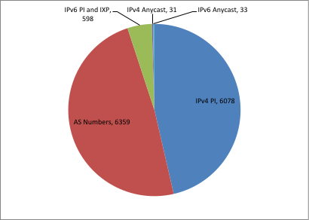
Phase One figures (new assignments)
13,099 independent Internet number resources assigned since 3 March 2009

Slide 4
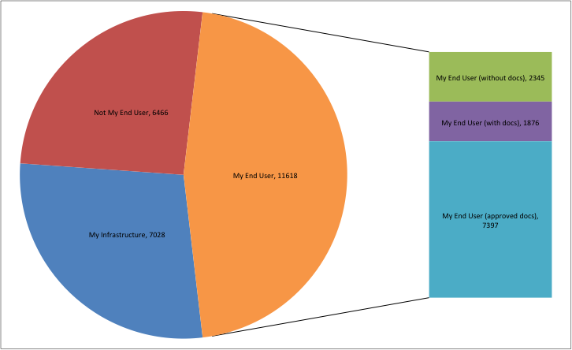
Phase Two results (existing assignments)
Feedback received for 25,112 independent number resource assignments between May 2009 and March 2011

Slide 5
Phase Three – “Orphaned Assignments”
Directly contacting End Users who have not entered a contract with a sponsoring LIR or the RIPE NCC
Started 15 March 2011
End Users are asked to fill in a feedback form; RIPE NCC to follow up based on the End User feedback
Independent Internet number resources listed in closed registries are also included in Phase 3 (approx. 6,800)

Slide 6
Phase Three - Process
Contacting End User in batches, prioritised by resource visibility in global routing table
Resource visibility: current, recent (< 12 months), old (> 12 months)
Using different levels of contact information in RIPE DB
End Users will be directed to an online form to provide feedback regarding resource usage, holdership, etc.
Monitoring activity on online forms and keeping logs
Manual follow-up by the RIPE NCC

Slide 7
Phase Three results and progress
started in March 2011 (18,730 resources)
6,300 resource holders contacted since March (33%)
12,000 emails with Feedback Form (25% bounces)
2,400 responses received (40% of contacted resource holders)
3,800 emails sent as manual follow-up on feedback
feedback for over 1,600 resources completed so far

Slide 8
Phase Three – completed resources

Slide 9
Conclusions
Phase 1 and 2 very successful
Phase 3 more challenging… but we expected that.
High number of unused resources returned to the RIPE NCC
Most importantly, more accurate, complete and current RIPE registry

Slide 10
Questions?

