Slide 1
ARIN Update
RIPE 63
Nate Davis
Chief Operations Officer

Slide 2
2011 Focus
IPv4 Depletion & IPv6 Uptake
Developing, adapting, and improving processes and procedures
Continue IPv6 outreach
Implementation of new policies and services
Continued development and integration of web-based system (ARIN Online)
DNSSEC and RPKI deployment
Continued participation in Internet Governance forums

Slide 3
ARIN Inventory Report
~5.67 /8s in available inventory
Doesn’t include quarantined space (reclaimed/returned space held for 6 months to clear filters, ~6.7 /16s)
Notes:
These figures were accurate on 28 October 2011

Slide 4
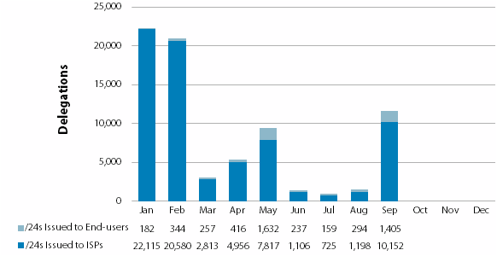
2011 IPv4 Delegations Issued By ARIN
**1.16 /8s issued in Q1-Q3 2011
Notes:
Allocation rate is way down - Issued only 1.16 /8s in first 9 months of this year, partially due to new policy that allows ISPs to request only a 3 month supply of addresses, also larger ISPs have not been requesting space, may be due to saturation in certain markets

Slide 5
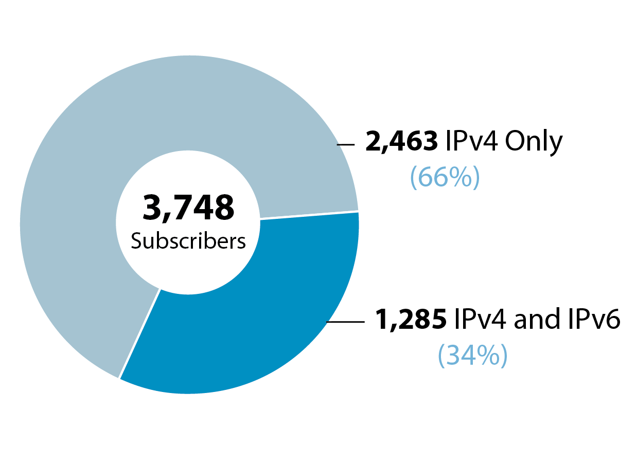
ISP Members with IPv4 and IPv6
3,748 ISP subscriber members

Slide 6
New Policies Implemented
ARIN-2011-3: Better IPv6 Allocations for ISPs
Enables ISPs to request larger blocks of IPv6 space on nibble boundaries
Implemented up to /24s
ARIN-2010-14: Standardize IP Reassignment Registration Requirements
Expands the “cable IPv4 allocation policy” to all ISPs with residential/DHCP-type customers (lowers utilization threshold, increases utilization information requirements)
Requires SWIP for /64 and larger static reassignments
Mandates Abuse POCs

Slide 7
Proposals after ARIN 28
Last call (ends 2 November)
ARIN-2011-8: Combined M&A and Specified Transfers
ARIN-2011-9: Global Policy for post exhaustion IPv4 allocation mechanisms by the IANA
ARIN-2011-10: Remove Single Aggregate Requirement from Specified Transfer
Extended last call (ends 16 November)
ARIN-2011-1: ARIN Inter-RIR Transfers
Need more work
ARIN-2011-7: Compliance Requirement
ARIN-2011-11: Clarify Justified Need for Transfers
ARIN-2011-12: Set Transfer Need to 24 months
Abandoned
ARIN-2011-13: IPv4 Number Resources for Use Within Region
https://www.arin.net/policy/proposals/
Notes:
Accurate through 4 November 2011
At ARIN there are also a couple new proposals, see the URL

Slide 8
Public Facing Development Efforts
ARIN Online
Billing integration initiated
Templates and corresponding RESTful modules protected by API Keys
IRR
Rolled out a revamped IRR on September 29
Added CRYPT-PW, PGP, and email notification of object updates
Value Added Security Services
RPKI
Hosted to be completed in 2012
Delegated to be done in 2012
DNSSEC
Fully implemented and operational
Notes:
one manages their rpki through our web interface, delegated is where they setup their own rpki system and work through a interface called up/down
delegated they also setup their own website/database/whatever for their local changes

Slide 9
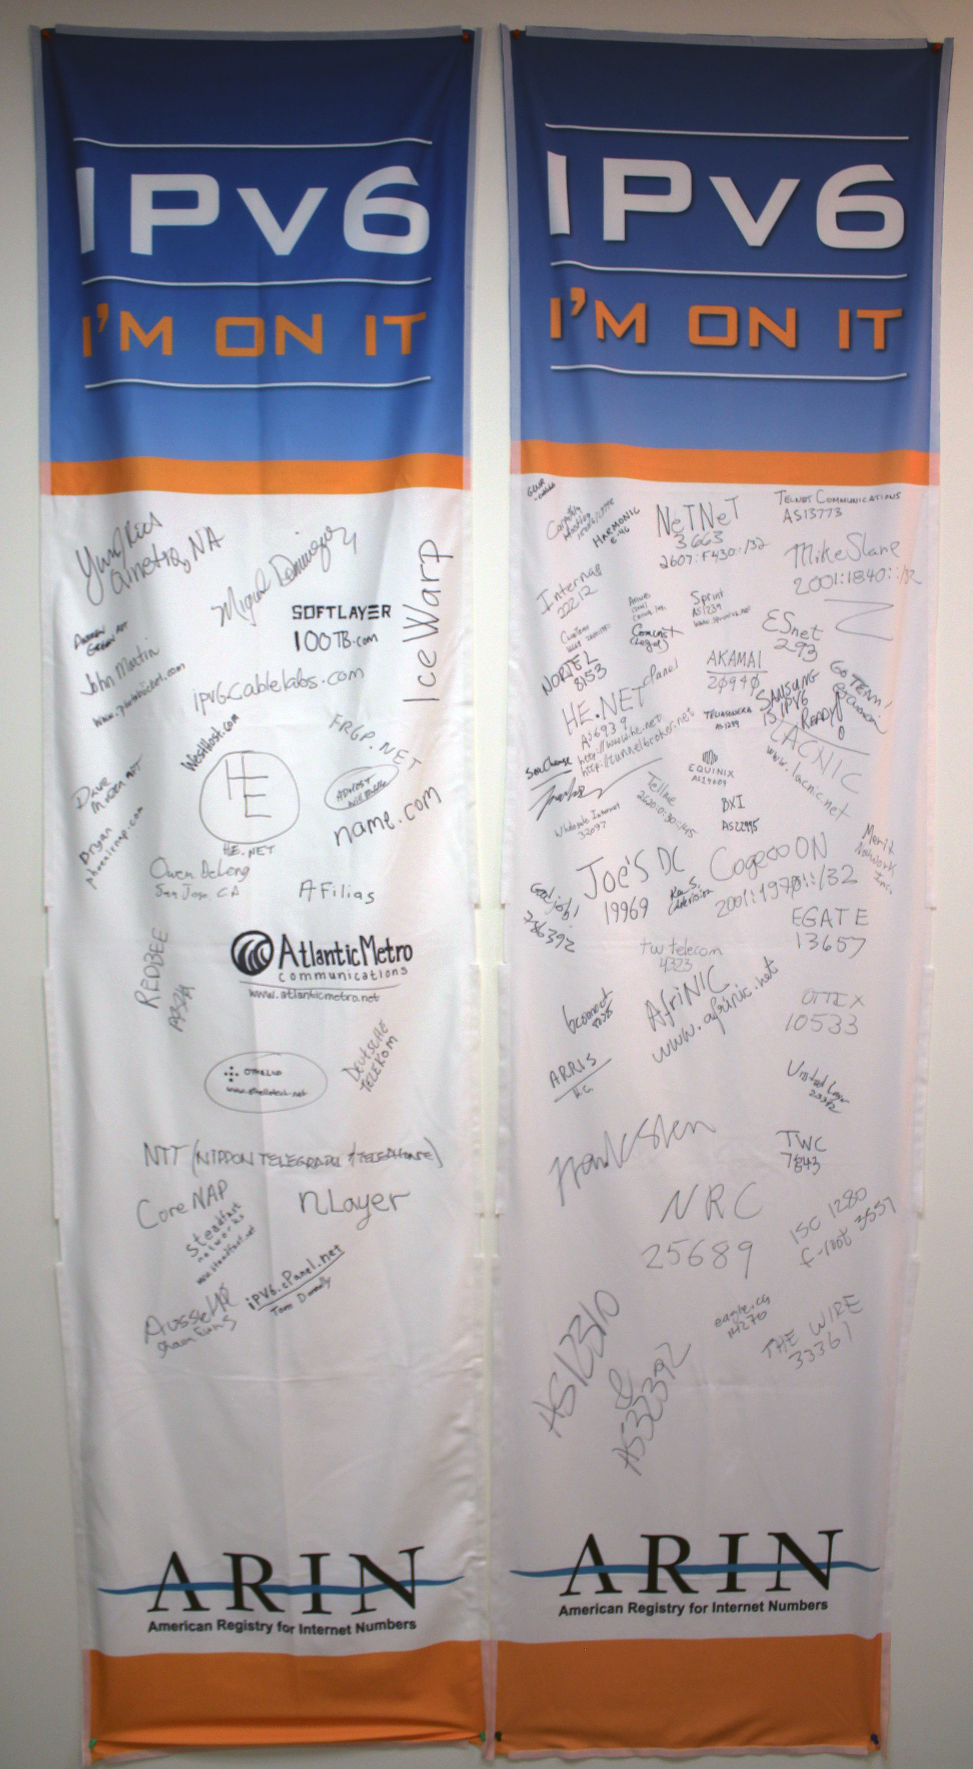
2011 Outreach Events
Ongoing participation in various local, national and international forums, focus on IPv4 depletion and IPv6 adoption.
Events include:
ARIN on the Road (Boston, San Jose, Montreal)
Consumer Electronics Show
Pacific Telecom Conference
Joint Techs / Internet2
ICT Roadshow events
TTVN
IT Roadmap
Game Developers Conference
Enterprise Connect
Interop
CANTO
FOSE
OSCON
HostingCon
Satellite 2011
The Cable Show
Light Reading Live
Rocky Mountain IPv6 Summit

Slide 10
Upcoming ARIN Meetings
Network Sponsor
Network Sponsor
Notes:
Similar to 6to4

